Slide 1

Intro to Machine Learning
YOUR COURSE NAME | IRONHACK

Slide 2



IRONHACK BOOTCAMP
Agenda
Machine Learning
Supervised Learning
Unsupervised Learning
Credit: Unsplash

Slide 3
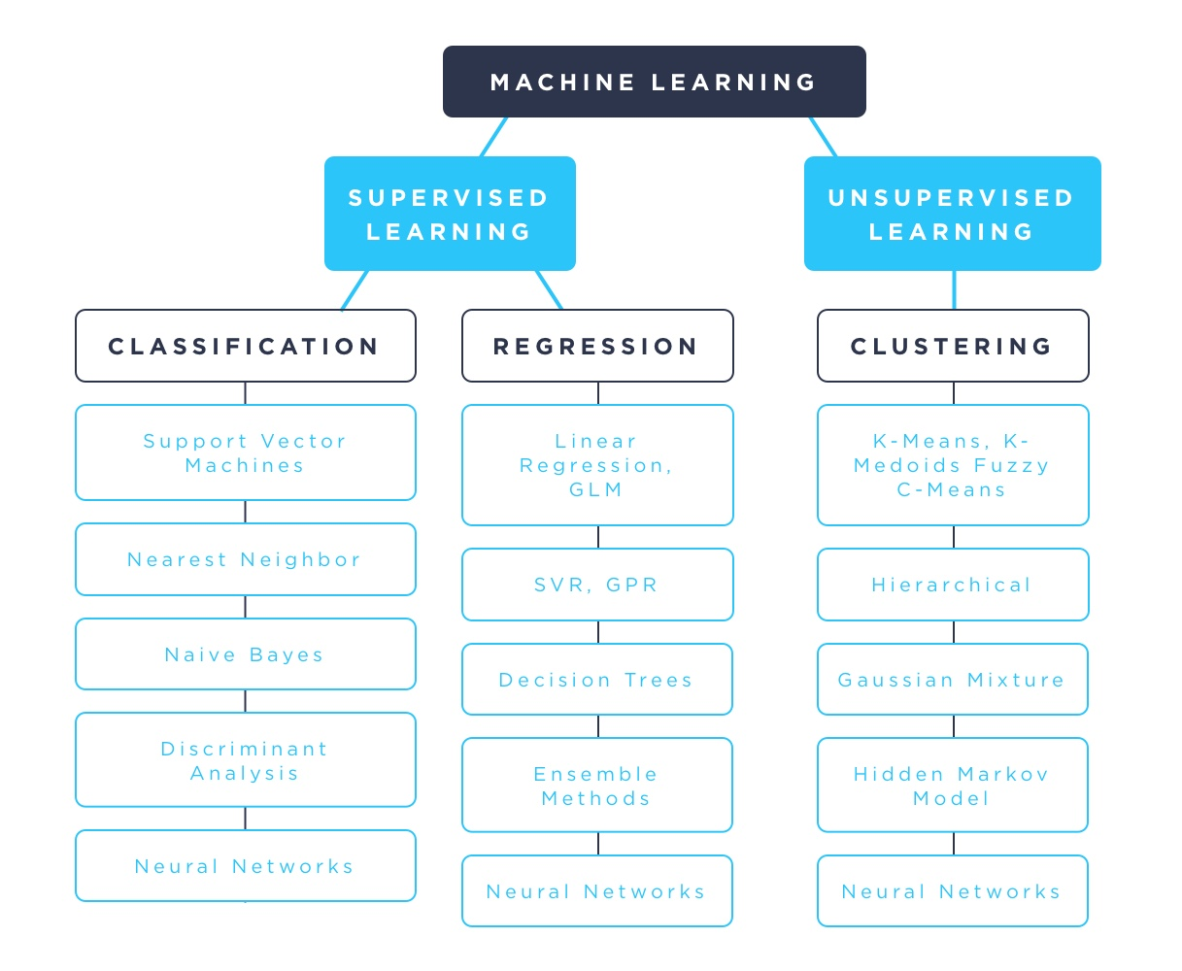
IRONHACK BOOTCAMP

Slide 4

Supervised Learning.

Slide 5
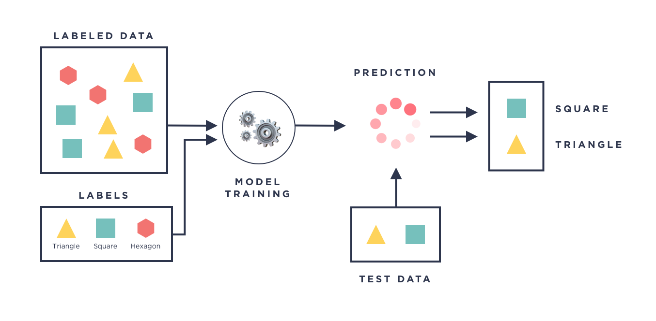
IRONHACK BOOTCAMP

Slide 6
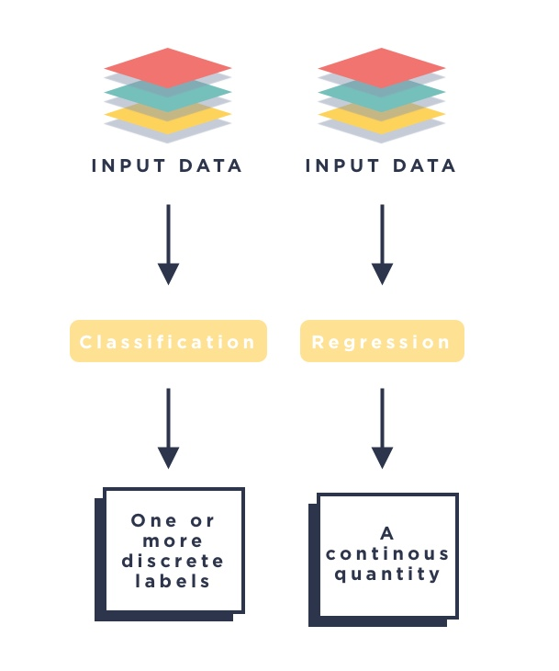
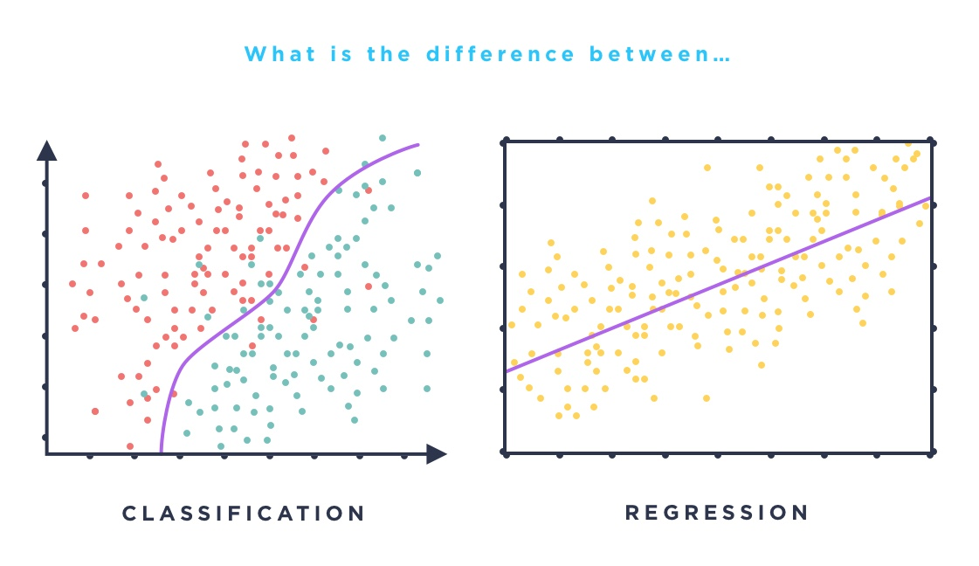
IRONHACK BOOTCAMP

Slide 7
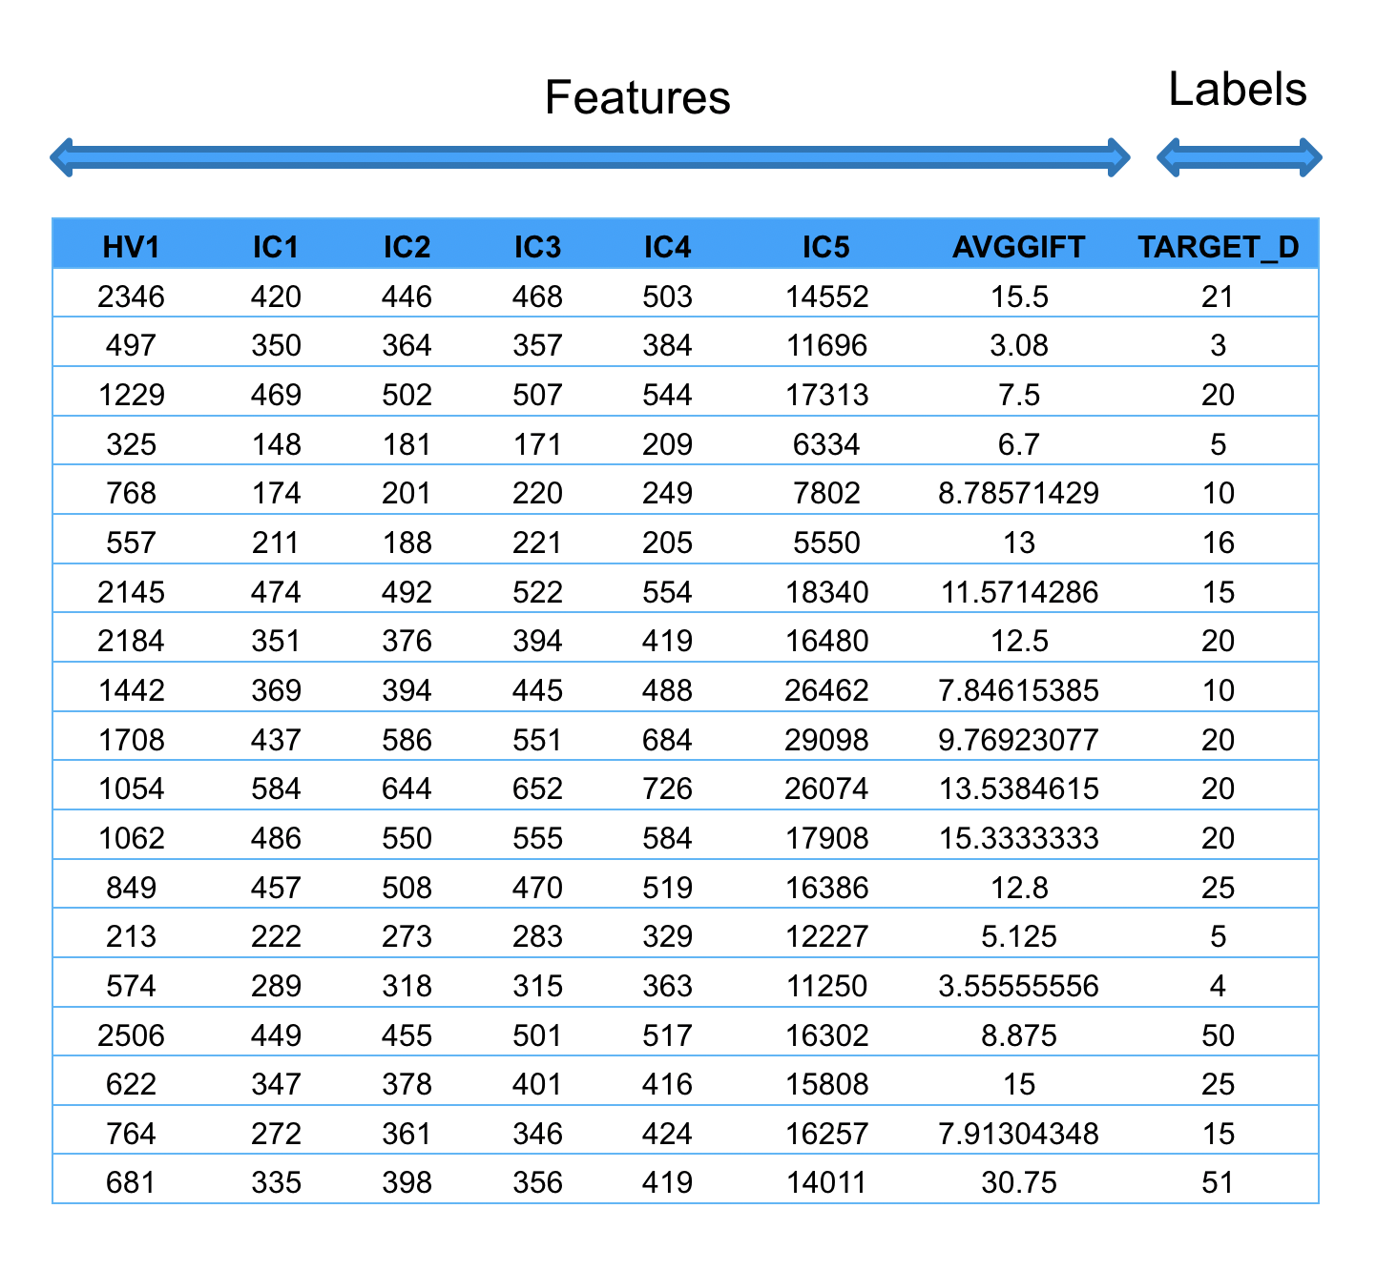
IRONHACK BOOTCAMP
Regression problem = we are aiming to predict a number
In this case we will try to predict TARGET_D based on the other features we have in the data

Slide 8
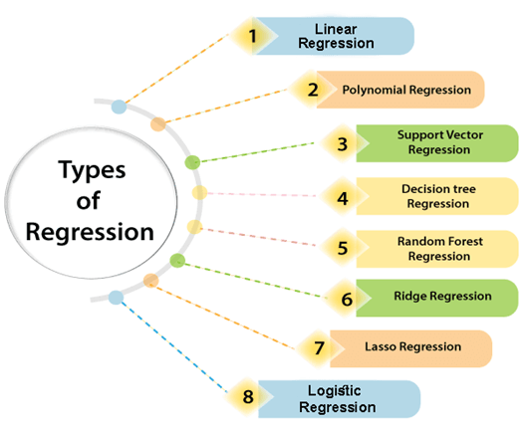
IRONHACK BOOTCAMP

Slide 9
IRONHACK BOOTCAMP
The assumptions of the Linear Regression approach
1) Linearity: The relationship between X and the mean of y will be linear (theoretically, we can predict y based on X)
2) X is continuous: all of the features going into our model will be numerical (we would encode any objects/strings)
3) Independence: Observations are independent of each other. We will not have two rows which represent the same individual, event or instance.
Other recommendations :
Scaling the features so that all elements of x are on a similar range of values could make interpreting the coefficients easier and the model more efficient.

Slide 10
IRONHACK BOOTCAMP
Steps of applying the Linear Regression model:
Choose our features (including dropping any highly correlated features)
Ensure there are no nulls in the data.
Consider removing outliers and using power transformations to make independent variables resemble a normal distribution
Transform all non numeric features through encoding
Separate the target label (as y)
Randomly divide into test and training data sets
Train our model
Apply the trained model to the test data set
Evaluate the model - how much of the variation in test does our linear regression model explain?

Slide 11
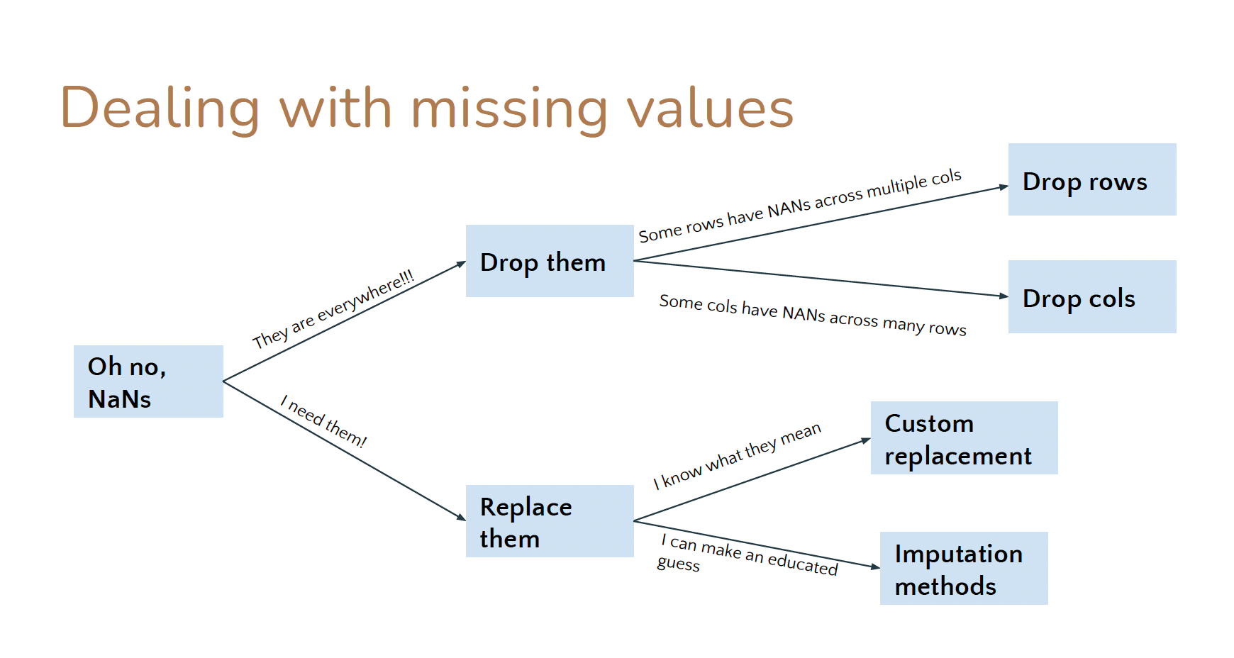
IRONHACK BOOTCAMP

Slide 12
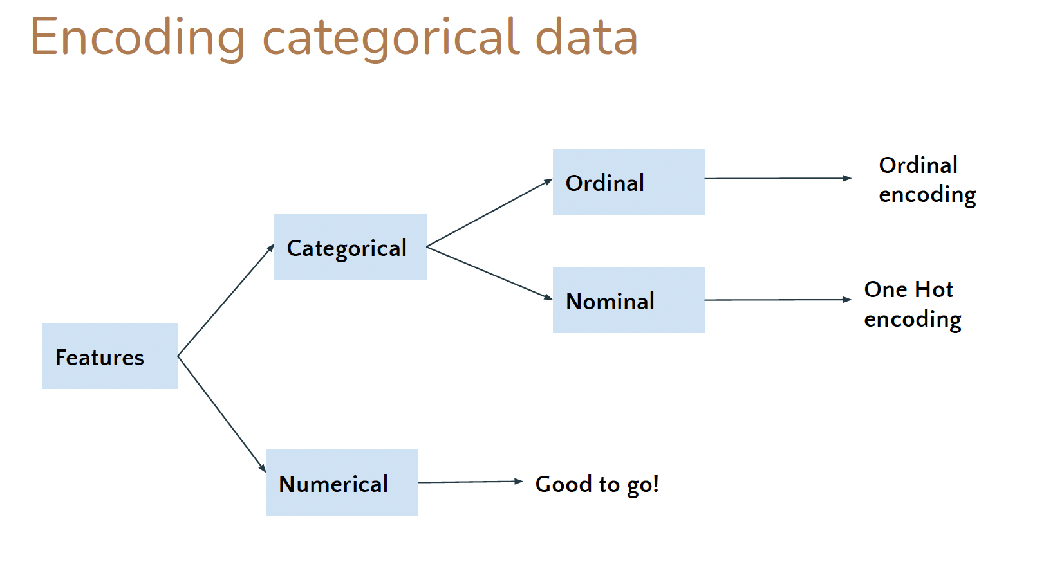
IRONHACK BOOTCAMP

Slide 13
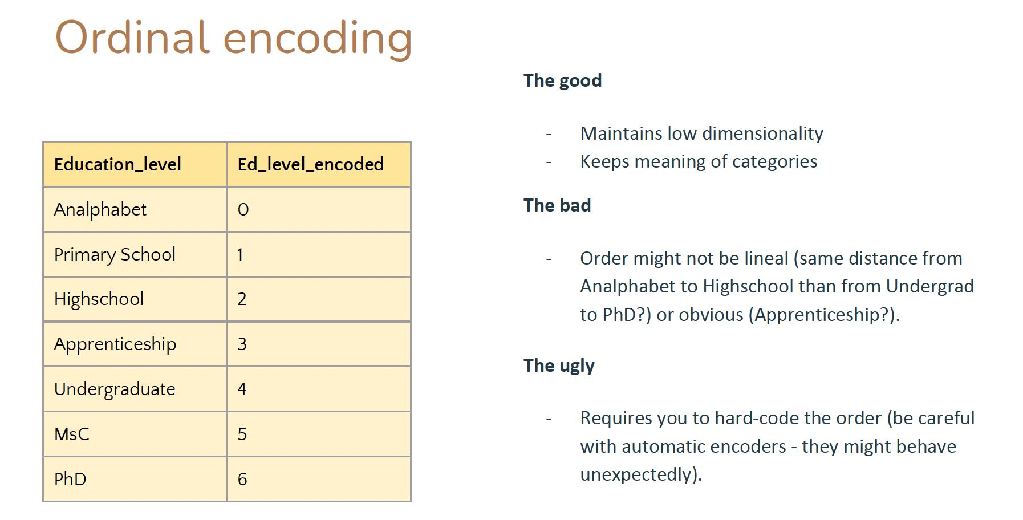
IRONHACK BOOTCAMP

Slide 14
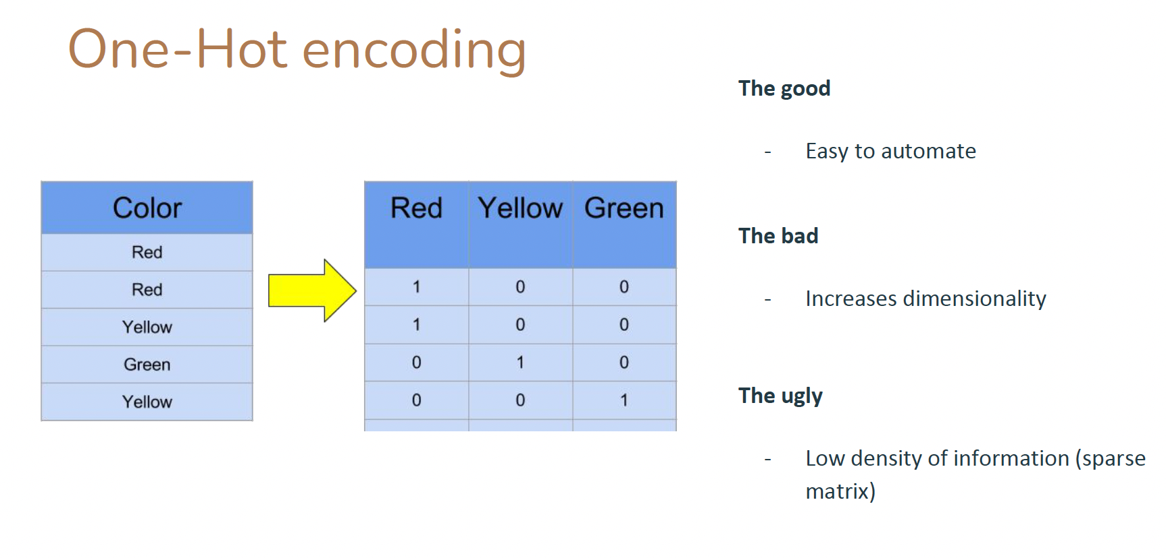
IRONHACK BOOTCAMP

Slide 15
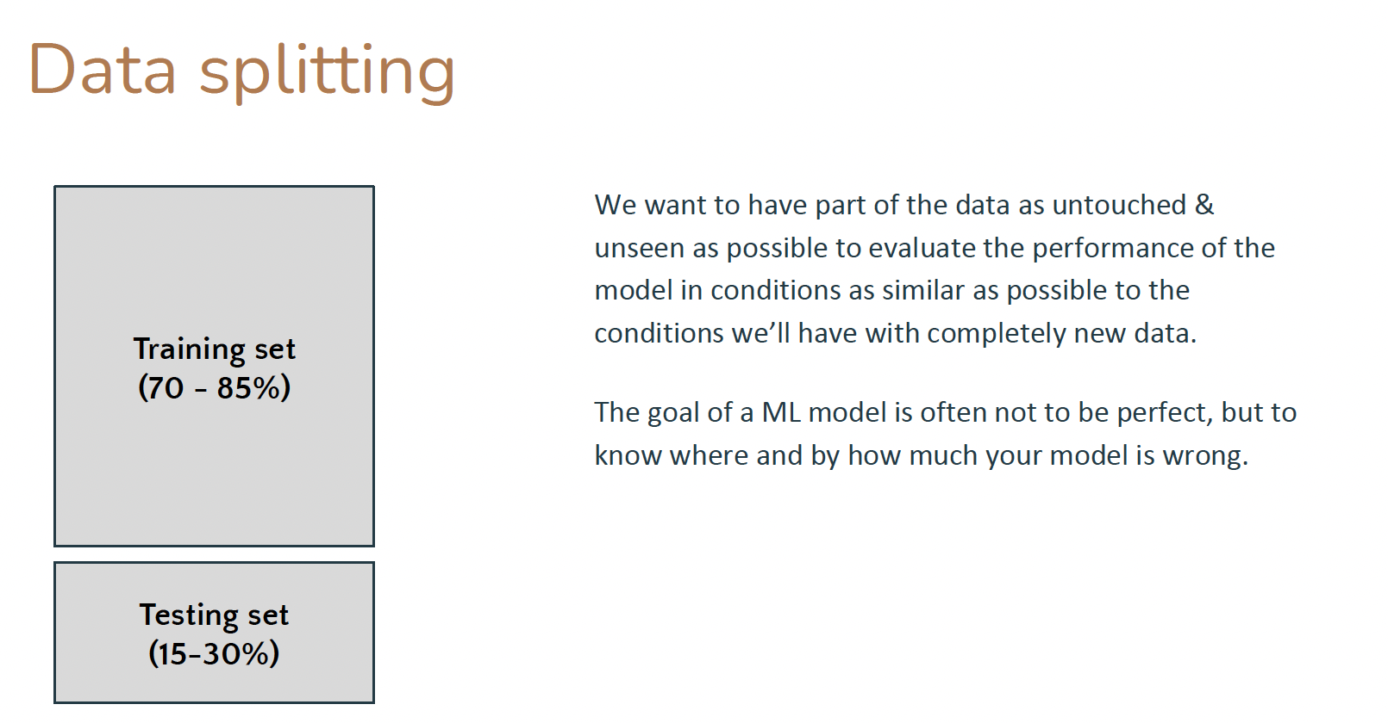
IRONHACK BOOTCAMP

Slide 16
Unsupervised Learning.

Slide 17
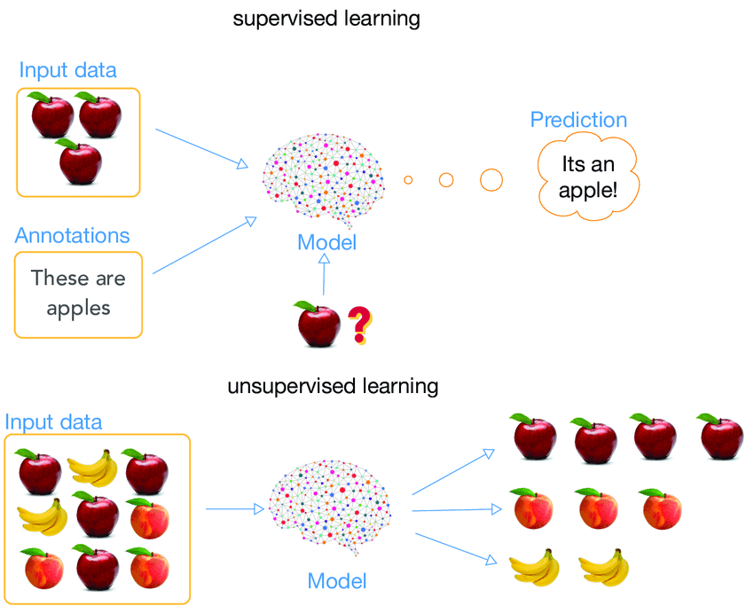
IRONHACK BOOTCAMP

Slide 18
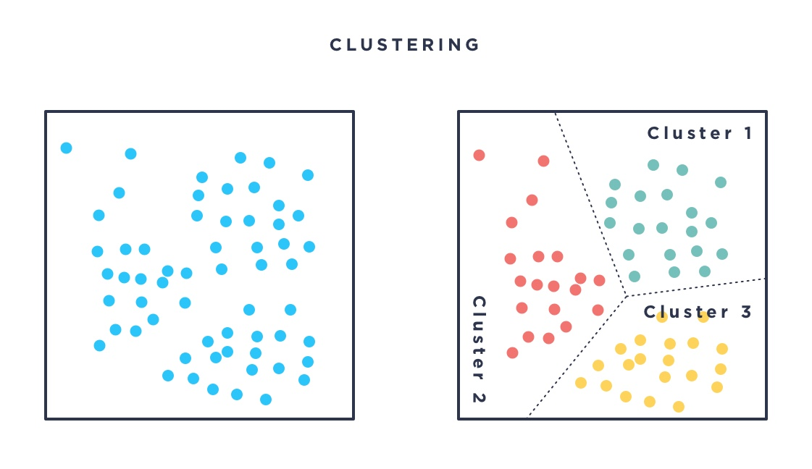
IRONHACK BOOTCAMP

Slide 19
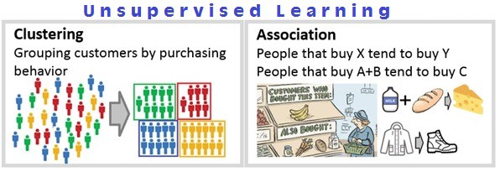
IRONHACK BOOTCAMP

Slide 20


